Slide 1



2016 INCIDENT ANALYSIS
BY
DANIEL EBENUWA

Slide 2
AGENDA
Introduction
Data Preparation
Insights
Conclusion

Slide 3

INTRODUCTION
This analysis aims to derive useful insights from Incident data related to offshore and onshore wind operations. As the sector expands, safety must come first. The goal is to find patterns, possible hazards, and opportunities for safety enhancements.
The aim is to inform plans that will lower incident rates and raise safety standards through thorough data cleansing and PowerBI visualisations, highlighting the industry's commitment to sustainable development and its workforce.

Slide 4


DATA PREPARATION
To ensure the integrity of this analysis, I undertook a thorough data-cleaning process.
This included:
Handling Missing Data
Syntax Correction
To preserve data continuity, relevant values were inserted into empty cells.
To guarantee accuracy in classification and analysis, typographical errors were fixed.

Slide 5




INSIGHTS
From the analysis performed on the dataset, below are my findings
WE HAD 983 TOTAL INCIDENTS
BETWEEN THE UK AND EU, WE HAD 21,726,000 OF HOURS WORKED
248 INCIDENTS OCCURED IN THE EU
735 INCIDENTS OCCURED IN THE UK

Slide 6
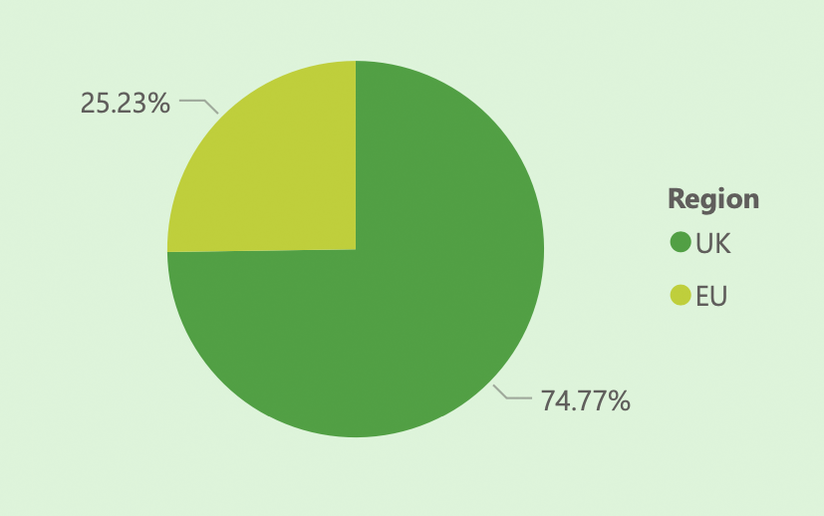
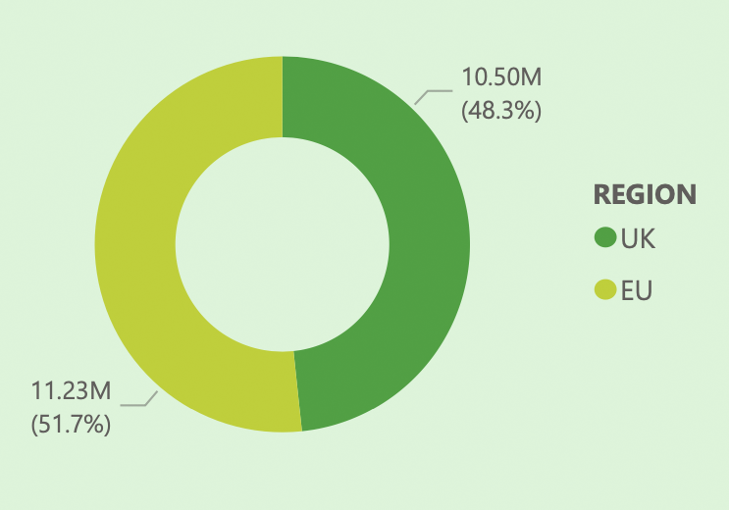
From the chart below, we can see that despite the EU working more hours than the UK, the UK still had significantly more incidents than the EU with the UK incident totalling 74.77% of the total incidents for the year 2016
UK VS EU INCIDENT
HOURS WORKED COMPARISON

Slide 7
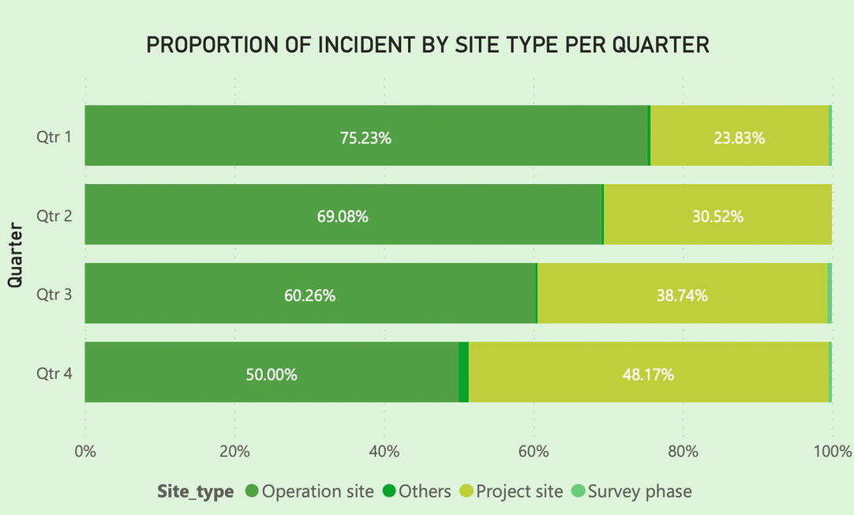
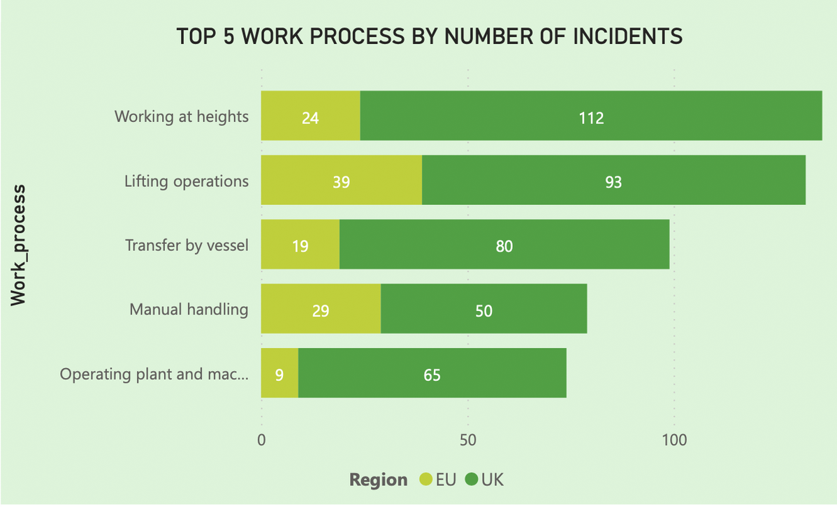
Analysing the chart below, we notice that for each quarter, operation site is where most incidents occur, followed by project site.
By viewing the top 5 work processes in figure B, we can see that working at heights is the most incident prone work process. However, looking at the region breakdown we see that in the EU, most incidents happened under lifting operations, followed by manual handling.

Slide 8
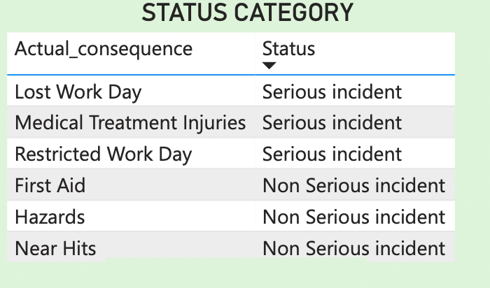
Using the actual consequence categories, a severity flag was created marking incidents as “Serious” vs “Non Serious”. The table on the left shows the classification assigned for each consequence.
From the table created, some new insights where found:
116 incidents were classified as serious incidents
867 incidents were classified as non serious incidents
Among the serious incidents, only 10 required medical evacuation.

Slide 9
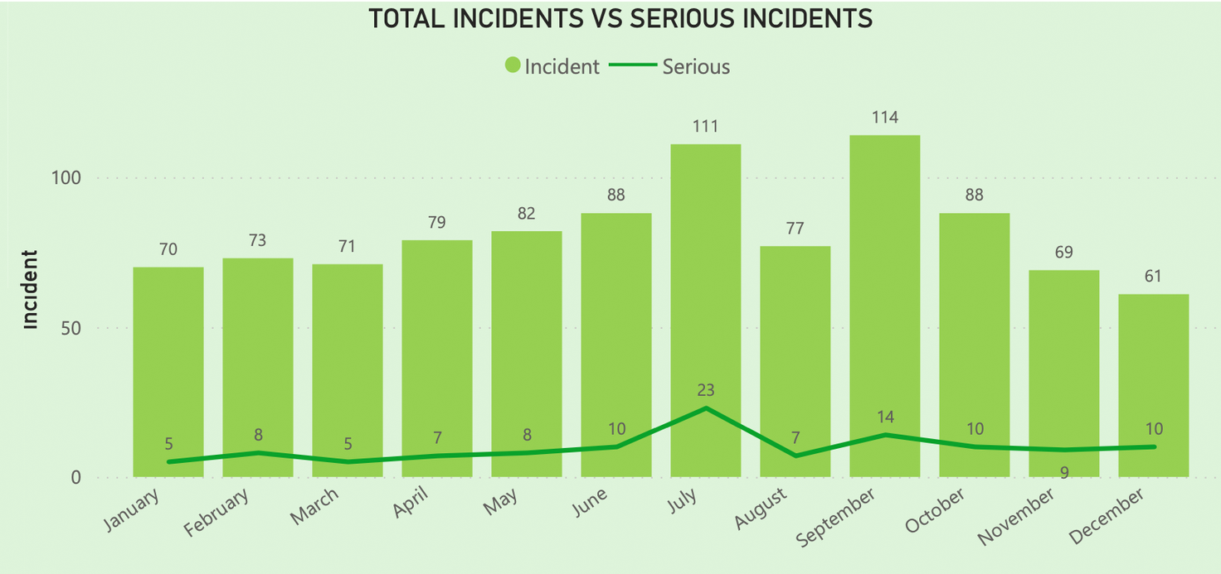
Comparing the total number of incidents with serious incidents, we can see from the chart below that:
September was the month with the highest number of incidents
July had the second highest incident count, and the worst incident to serious incident ratio at 5:1

Slide 10
Mon-Year | Total Incidents | Serious Incidents | Ratio
Jan-2016 | 70 | 5 | 14:1
Feb-2016 | 73 | 8 | 9:1
Mar-2016 | 71 | 5 | 14:1
Apr-2016 | 79 | 7 | 11:1
May-2016 | 82 | 8 | 10:1
Jun-2016 | 88 | 10 | 8:1
Jul-2016 | 111 | 23 | 5:1
Aug-2016 | 77 | 7 | 11:1
Sep-2016 | 114 | 14 | 8:1
Oct-2016 | 88 | 10 | 9:1
Nov-2016 | 69 | 9 | 8:1
Dec-2016 | 61 | 10 | 6:1

Slide 11
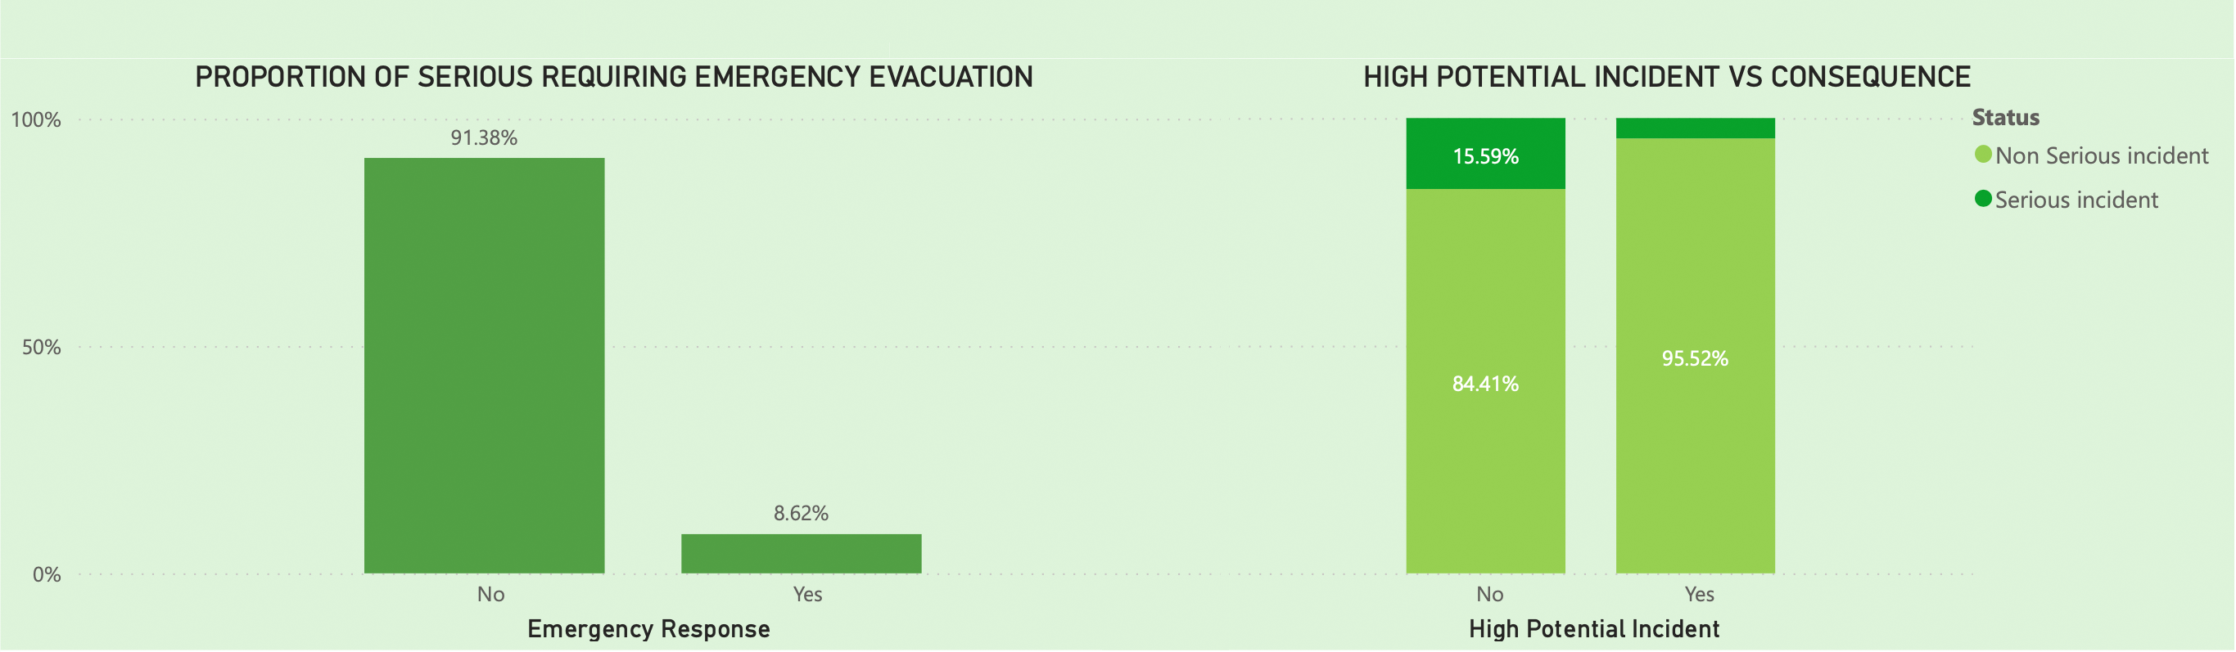
Below we have a breakdown of serious incidents requiring medical evacuation, and a breakdown or incidents that were marked as high potential.
91.38% of serious incidents did not need emergency evacuation
Looking at the high potential incident flag, 15.59% of incidents that were not marked as high potential incidents resulted in a serious consequence

Slide 12
CONCLUSION
In conclusion, the UK is seen to have much more incidents than the EU, even though they worked less hours that year. We also see a difference in the work processes that resulted in the most incidents.
Out of the 983 incidents in 2016, 11.8% resulted in a serious consequence. However only 10 ( 1% of total incidents) required emergency medical evacuation. There were also no fatalities that year.
In terms of the potential of a incident occuring, 16% of incidents that were marked as NOT having a high potential actually resulted in serious injuries.

Slide 13
SUGGESTION

